Slide 1

Classification Grouping Heart Disease Patients In The Hospital
By Charunthon Limseelo and Bhagya Saranunt
Advised by Assoc. Prof. Dr. Naruemon Wattanapongsakorn
This presentation is one of the assessment activity of CPE456: Data Mining Course of Computer Engineering Department (CPE)
Faculty of Engineering, King Mongkut’s University of Technology Thonburi
Template By Microsoft Build 2025 – Copyrights 2025

Slide 2
All Concerns from the first experiment

Slide 3
Concern No. 1
Less Ground Truth
in the Dataset

Slide 4
Less Ground Truth in the Dataset
Clustering cardiovascular diseases (CVDs) is challenging due to the complexity of the data and the need for expert knowledge to define meaningful groups. CVDs are often characterized by a wide range of risk factors and clinical presentations, making it difficult to simply apply standard clustering algorithms. Experts are crucial for defining what constitutes a meaningful cluster, as the "ground truth" (the known, correct grouping) may not be immediately apparent from the data alone.

Slide 5
Concern No. 2
There are more factors to consider before clustering

Slide 6
The Main Reason
Clustering of Cardiovascular Diseases (CVDs) is beneficial when considering imaging data, detailed cardiac biomarkers, and ECG wave data, as it allows for the identification of distinct subgroups of CVDs based on these factors. This helps in developing more targeted diagnostic and treatment approaches.
Our final approach will be changed from clustering patients by types of disease/root problems to the patients’ severity level.

Slide 7
Changes of the project
From Supervise ➡️ Semi-supervised

Slide 8
From Supervise to Semi-supervised
The most suitable way for clustering as changing from classifying heart disease type to heart disease severity. As it has less ground truth, we are now decided to be on Semi-supervised training instead.
Notes:
Keep it simple
So, what differentiates AI conversations and Agents
There are many definitions of an Agent
This is the definition we’ve settled on.
Simple as data analysis
Complex as onboarding a new hire
Semi-autonomous software that can be given a goal and will work to achieve that goal without you knowing in advance exactly how it's going to do that or what steps it's going to take.

Slide 9
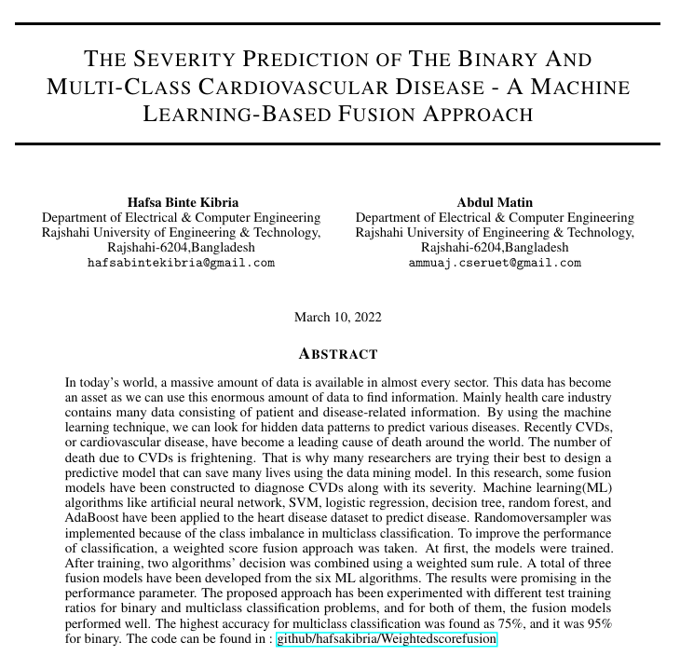
More Reference Added
The Severity Prediction of the Binary and Multi-Class Cardiovascular Disease – A Machine Learning-Based Fusion Approach
https://arxiv.org/pdf/2203.04921
Notes:
We're an outdoor and hiking equipment company and sell online
We'll use the power of AI to analyze our sales data
Reimaging a UX with GenAI that our sales team can use

Slide 10
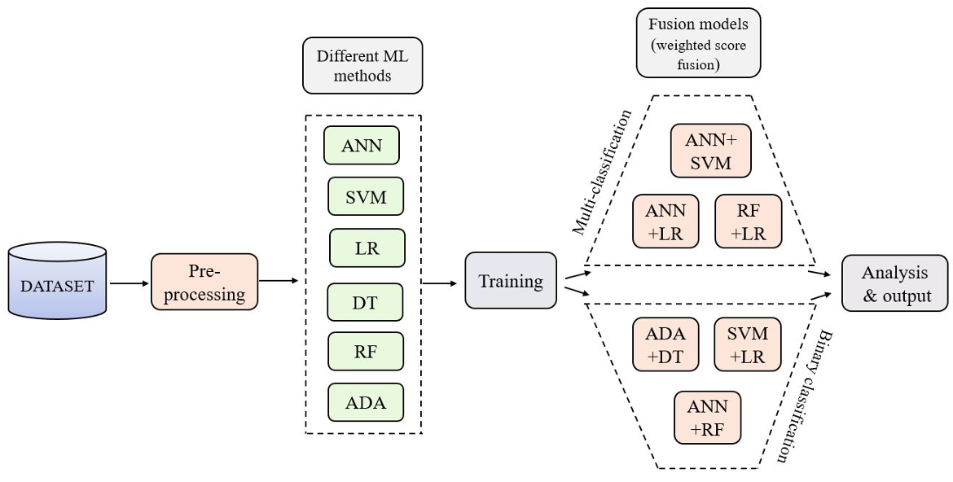
Proposed Architecture

Slide 11
Feature Engineering Analysis
- The Null values have been handled.
- The data are NOT Standardizing, Normalizing, or Scaling
Binary-class Data
- 1918 entries with labeled target
Multiclass Data
- 587 labeled data from Europe hospital
- 777 unlabeled data from India hospital

Slide 12
Used Features For Analysis – Attributes/Columns
age --> Age of the patient (28-77 in years).
gender --> Gender of the patient: typically 1 = Male, 0 = Female.
chestpain --> Type of chest pain experienced (encoded):• 1 = Typical Angina• 2 = Atypical Angina• 3 = Non-Anginal Pain• 4 = Asymptomatic
restingBP --> Resting Blood Pressure (in mm Hg) when the patient is seated and relaxed.
serumcholestrol --> Serum cholesterol level (in mg/dl).
fastingbloodsugar --> Whether the patient's fasting blood sugar is > 120 mg/dl:• 1 = Yes• 0 = No
restingrelectro --> Results of resting electrocardiographic test (ECG) (encoded):• 0 = Normal• 1 = ST-T wave abnormality• 2 = Possible left ventricular hypertrophy
maxheartrate --> Maximum heart rate achieved during exercise test.
exerciseangia --> Whether the patient experienced exercise-induced angina:• 1 = Yes• 0 = No
oldpeak --> ST depression induced by exercise relative to rest. (Numeric value showing how much the ST segment dropped below baseline after exercise.)
slope --> Slope of the peak exercise ST segment (encoded):• 1 = Upsloping• 2 = Flat• 3 = Downsloping
target --> Diagnosis of heart disease:• 0 = No heart disease• 1 = Presence of heart disease

Slide 13
Classification Testing
Binary Classification Baseline Model

Slide 14
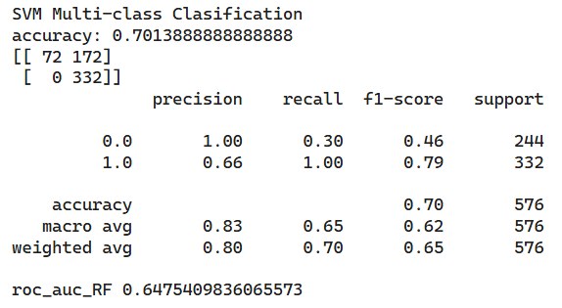
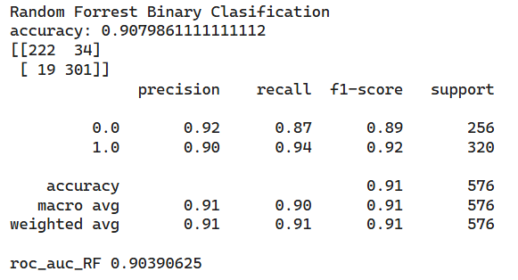
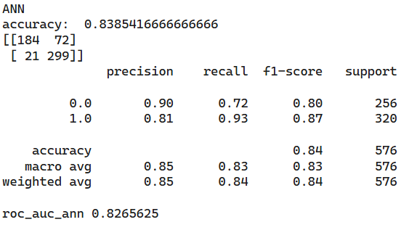
Model Accuracy
Support Vector Machine
Random Forest
Artificial Neural Network
Accuracy: 0.7013888
Accuracy: 0.907986111
Accuracy: 0.838541666
https://colab.research.google.com/drive/16W6xTJWUu6tzYtVBvq7xXw6psNiWdl-3?usp=sharing

Slide 15
Classification Testing
Multiclass Classification Based Model

Slide 16
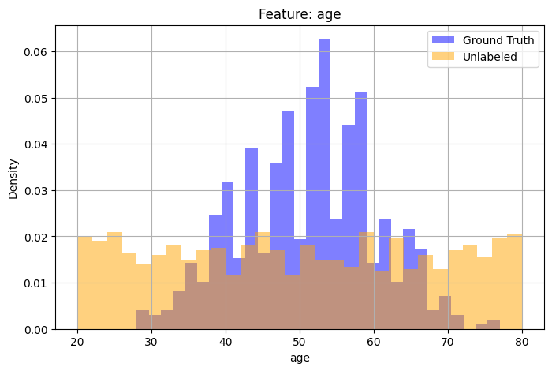
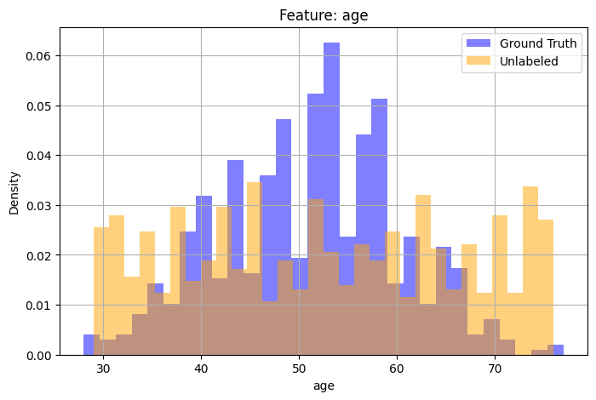
Unlabeled Data – Data Cleaning

Slide 17
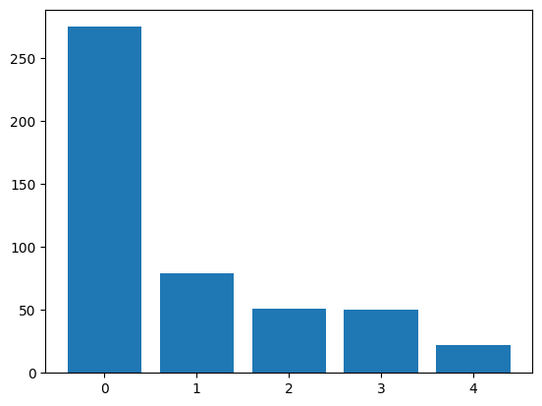
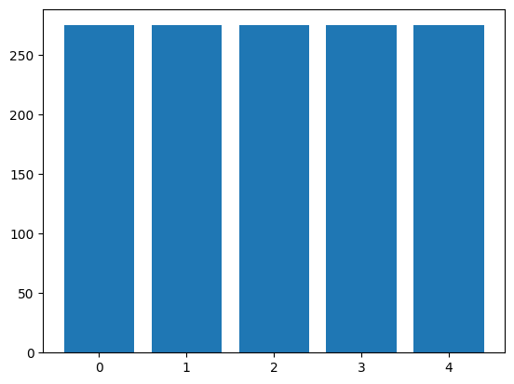
Up-sampling
Class=0, n=275 (57.652%)
Class=1, n=79 (16.562%)
Class=2, n=51 (10.692%)
Class=3, n=50 (10.482%)
Class=4, n=22 (4.612%)
The number of classes before fit Counter({0: 275, 1: 79, 2: 51, 3: 50, 4: 22})
The number of classes after fit Counter({0: 275, 1: 275, 2: 275, 4: 275, 3: 275})
Class=0, n=275 (20.000%)
Class=1, n=275 (20.000%)
Class=2, n=275 (20.000%)
Class=3, n=275 (20.000%)
Class=4, n=275 (20.000%)

Slide 18
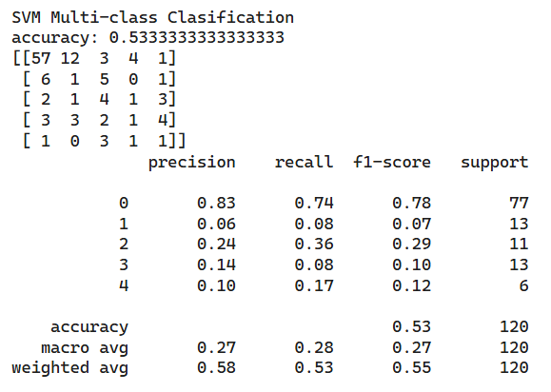
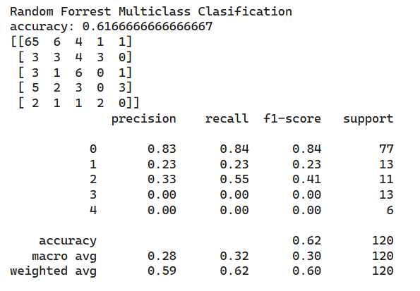
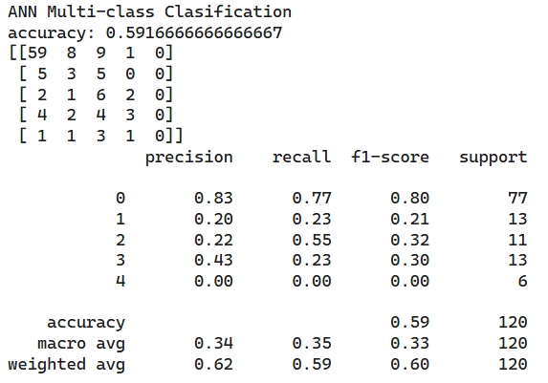
Model Accuracy
Support Vector Machine
Random Forest
Artificial Neural Network
Accuracy: 0.5333333
Accuracy: 0.616666666
Accuracy: 0.59166666
https://colab.research.google.com/drive/1alfoDE1z-FLbFyaNUpL9GRiepKtO1Mlf?usp=sharing#scrollTo=8vgpzKPfyuGH

Slide 19
Comparing The Accuracy for All Models
Binary Classification Based
Multiclass Classification Based
SVM: 0.7013888
Random Forest: 0.907986111
ANN: 0.838541666
SVM: 0.5333333
Random Forest: 0.616666666
ANN: 0.59166666
Can be more optimized

Slide 20
Learnings and next steps
Comparing accuracy and other metrics that can be used to apply on the project, and select two main models that need to be used for final project
Finalizing the final version of the conference paper format of the report.

Slide 21
Thank You | Q&A
Contact us by
Charunthon Limseelo
boat.charunthon@gmail.com or visit official website
Bhagya Saranunt
parksaranunt@gmail.com

